Slide 1
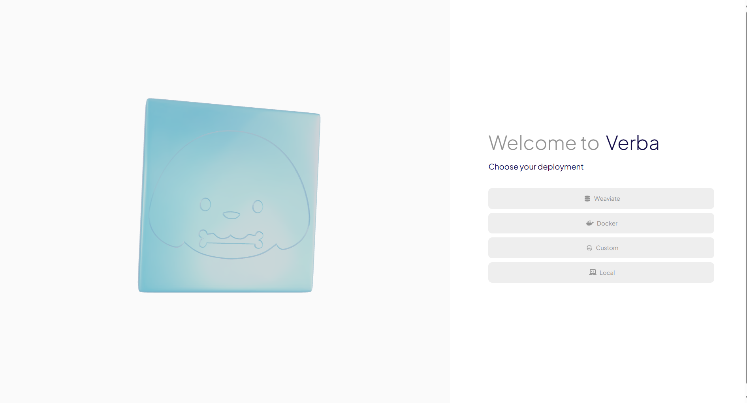
Retrieval Augmented Generation (RAG) Verba Application
ITAI 2372 – AI Applications
By: Michel Garcia, Hashim Sayed Hoosini Miguel Mora
Date: 07/05/2025

Slide 2

Presentation Outline
1
Introduction
What is Verba and its core concepts
2
Technical Details
Application stack and RAG pipeline
3
Implementation
Installation methods, configuration, and demo
4
Evaluation
Challenges, future improvements, and conclusion

Slide 3
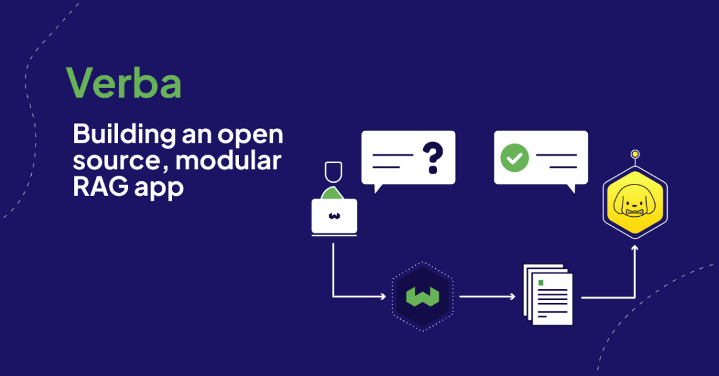

What is Verba?
Open-source RAG tool by Weaviate
Personalized answers based on user-uploaded documents
Uses vector search and LLM for response generation
Designed for privacy, transparency, and flexibility

Slide 4


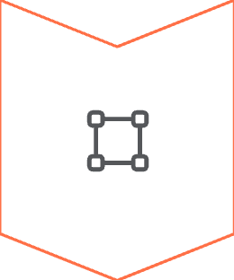
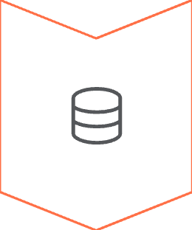
Core Concepts
Tokenization
Breaks text into readable chunks
Vectorization
Converts chunks into numeric embeddings
Indexing
Stores and retrieves data semantically

Slide 5

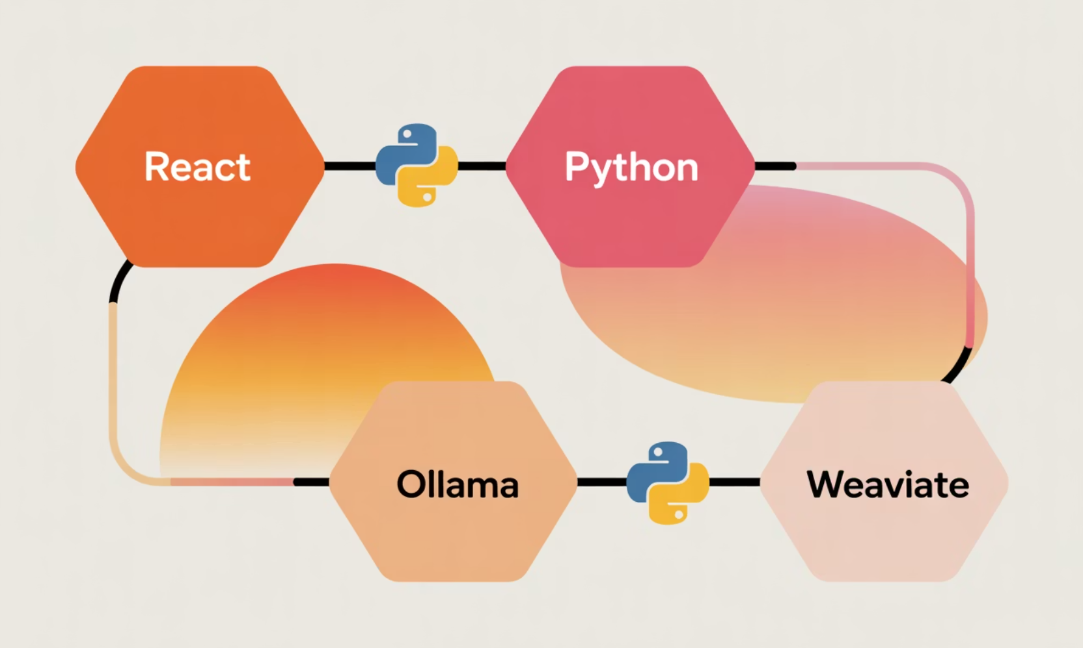



Application Stack Overview
Frontend
React-based web interface
Backend
Python + FastAPI
LLM Engine
Ollama (LLAMA3 used in this project)
Simple diagram of tech stack blocks
Vector Store
Weaviate via Docker

Slide 6
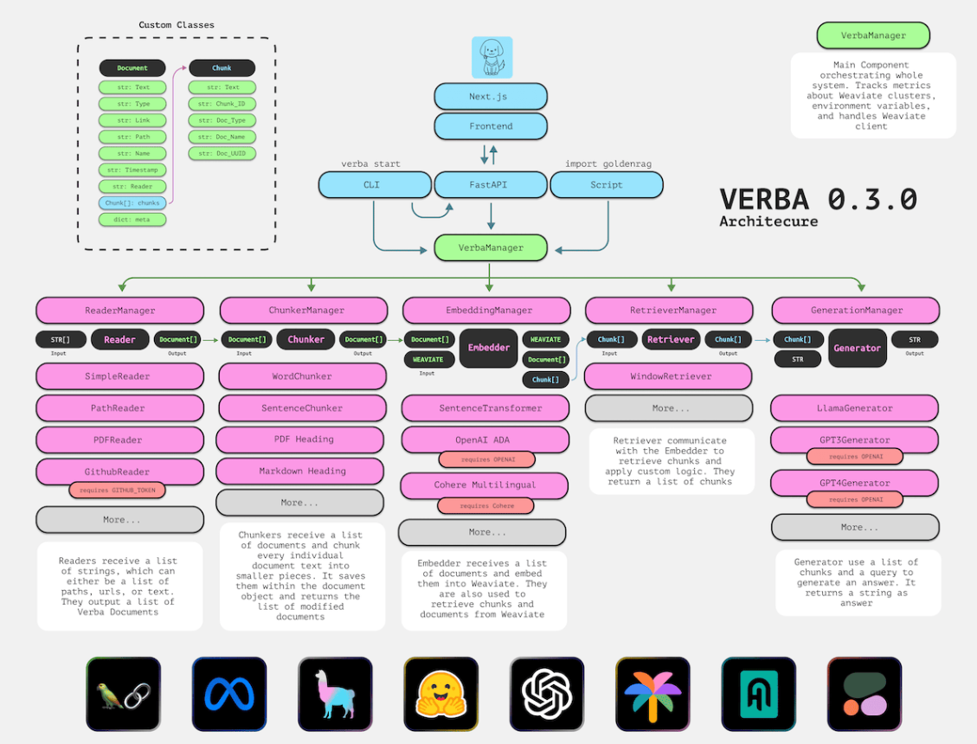
Modular RAG Pipeline
Reader Manager
Prepares text
Chunker
Splits into overlapping chunks
Embedding Manager
Converts to vectors
Retrieval Manager
Semantic + keyword search
Generation Manager
Produces answers
Flowchart of RAG pipeline

Slide 7
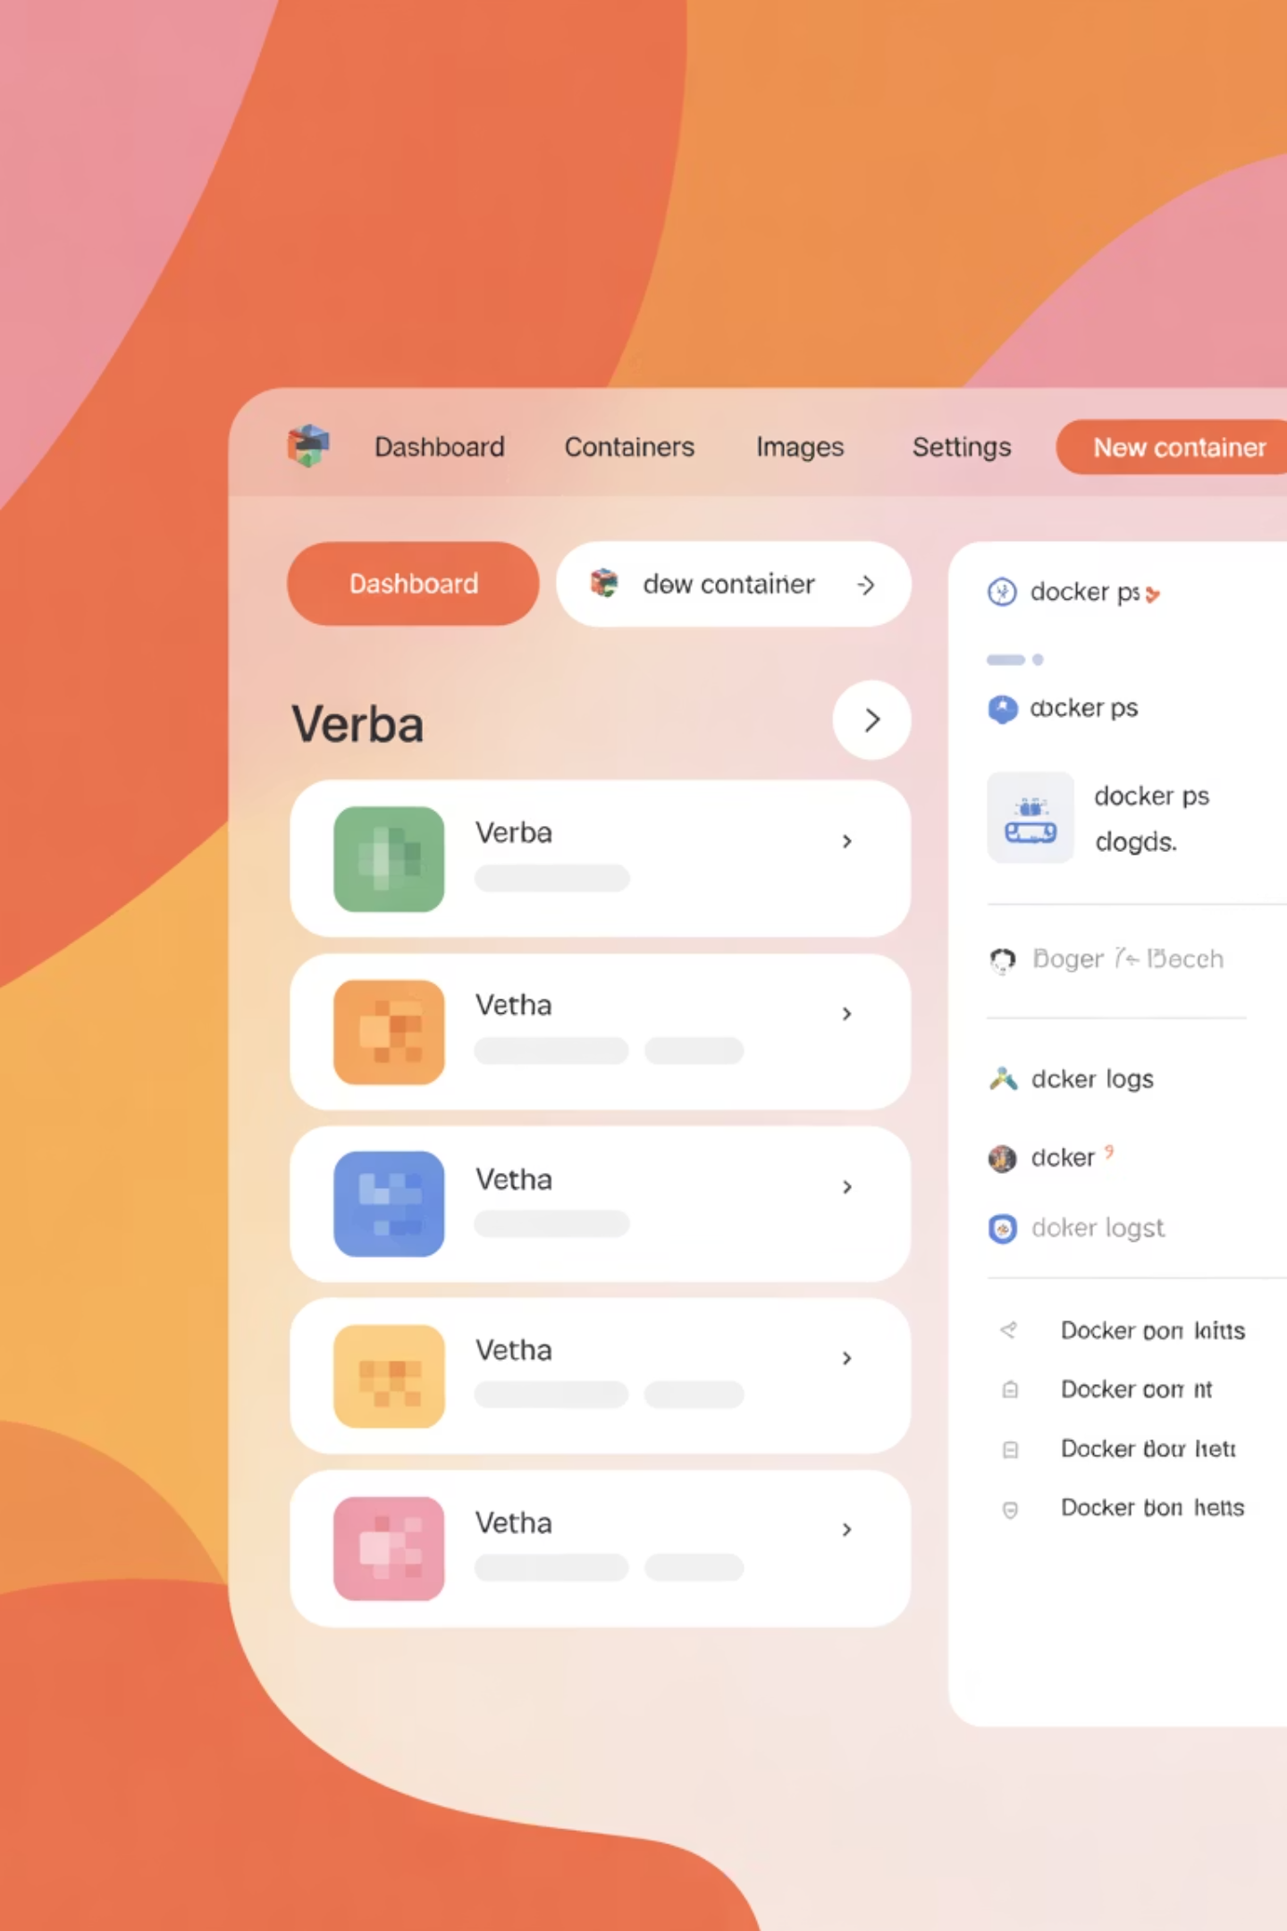
Installation Methods
Method 1
Method 2
From Source (for developers)
pip install goldenverba
Method 3
Docker-based setup (used for this case study)
Screenshot of Docker Desktop or CLI command

Slide 8
Docker Installation Steps
1
Clone GitHub repo
2
Set up .env with model and port
3
Modify docker-compose.yml
4
Run: docker compose up -d
5
Access at: localhost:8000
git clone https://github.com/weaviate/Verba.git
cd Verba
Configure .env and docker-compose.yml
docker compose up -d

Slide 9
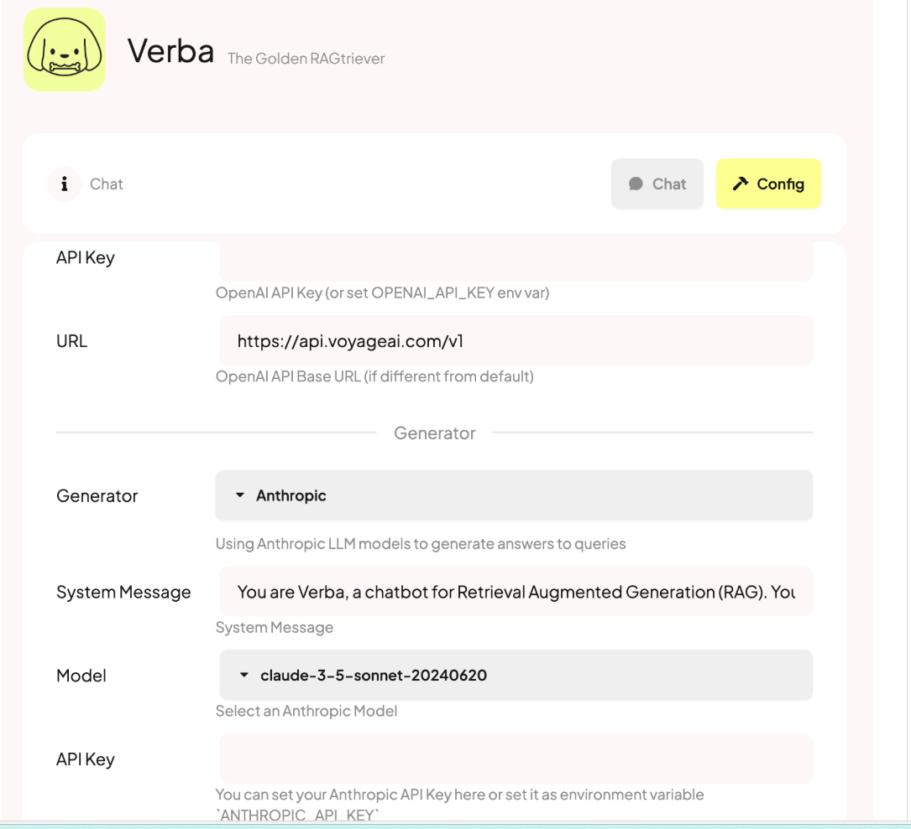
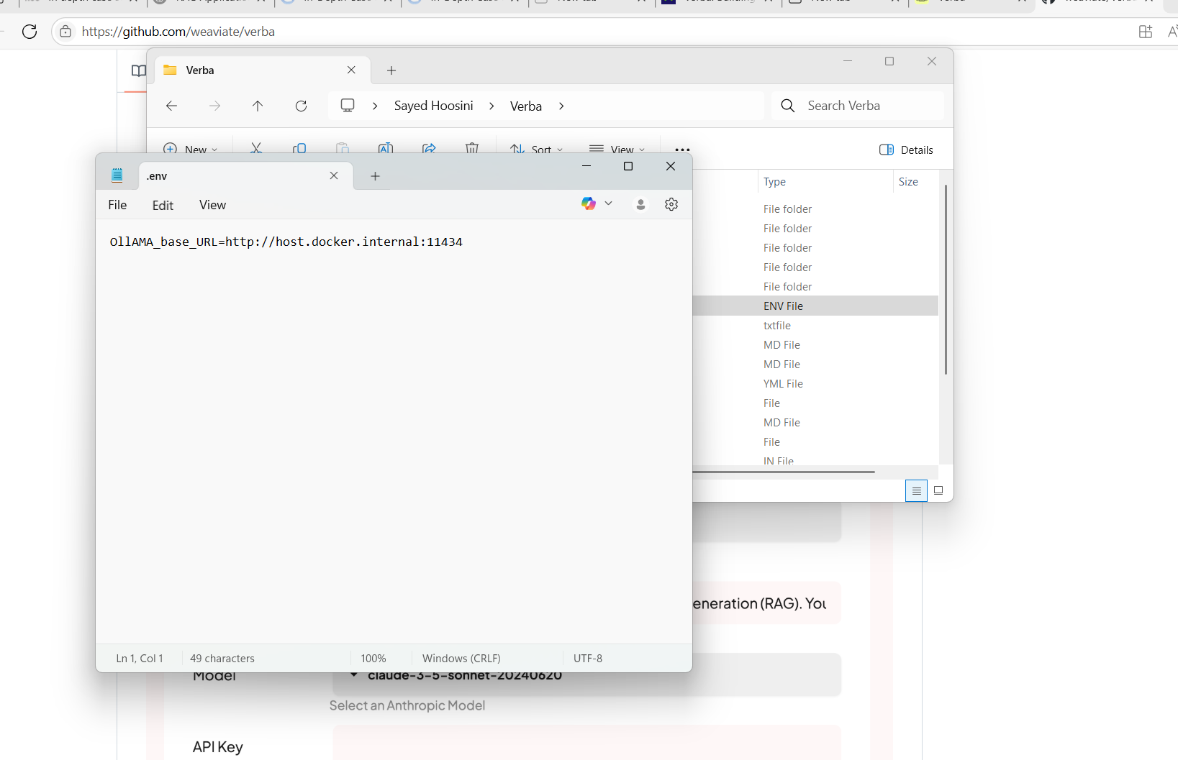
Configuration Details
.env file: model, port, log level
Supports OpenAI & Cohere API keys
Docker services: verba-web, weaviate, ollama
Can deploy to AWS, GCP, Azure
# Sample .env configurationMODEL=llama3PORT=8000LOG_LEVEL=infoOPENAI_API_KEY=sk-...
Screenshot of .env or config panel

Slide 10
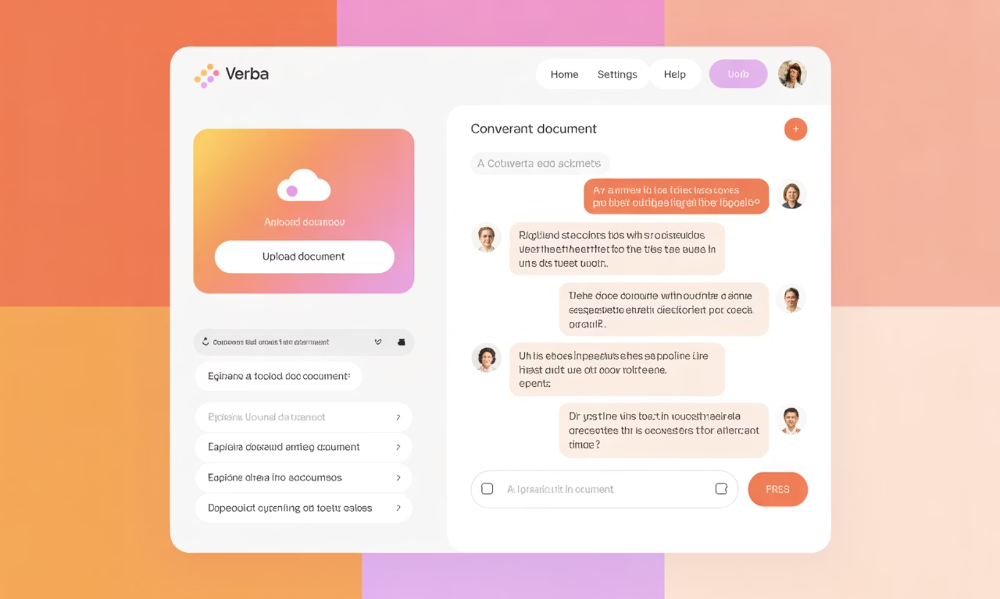
Demo Summary
Files uploaded: .txt, .docx, .pdf
Asked questions via chat
Fast loading: ~2 min total startup
Model: LLAMA3 via Ollama
Screenshot of Verba chat interface

Slide 11




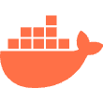
Challenges Faced
WSL Requirement
WSL required for Docker on Windows
File Limitations
PowerPoint/Excel files not supported
Performance Issues
Large files may slow the system
Technical Knowledge
Requires basic knowledge of Docker

Slide 12

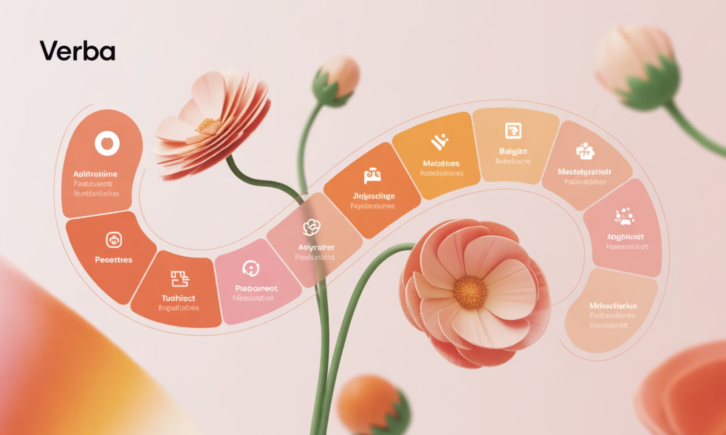
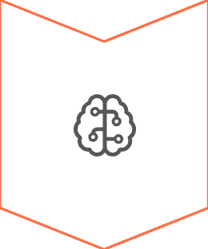

Future Improvements
Multi-user support
Better local model integration
Improved document control and privacy
Placeholder for future roadmap image

Slide 13
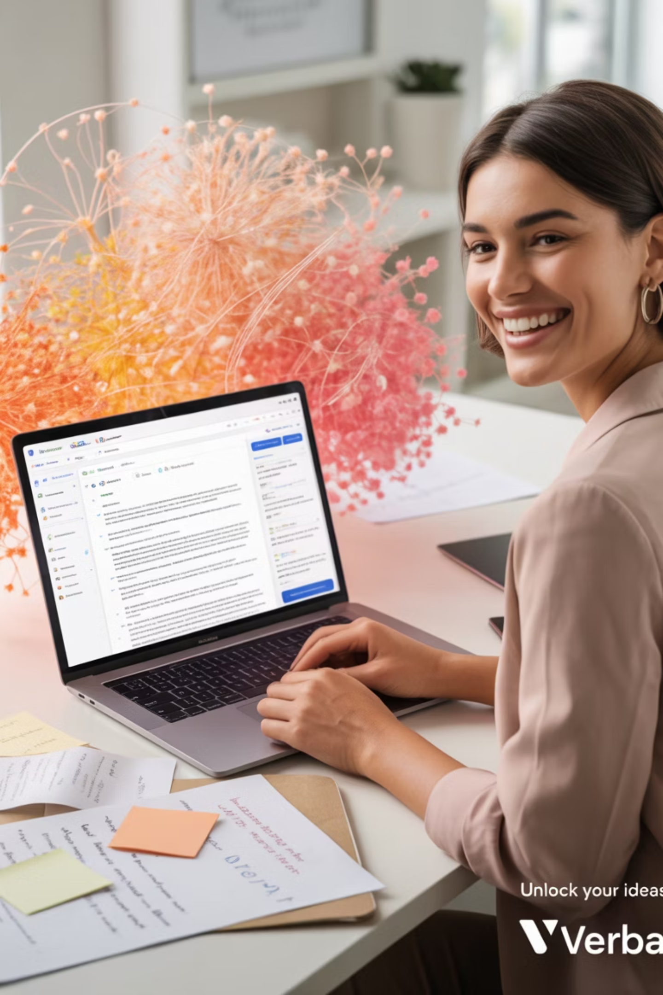
Conclusion
Verba shows the power of modular RAG tools
Enables private, AI-powered search over personal documents
Demonstrated successful installation, config, and use
Useful across industries and scalable for enterprise use

Slide 14
References
Victoria Slocum and Edward Schmuhl. “Verba: Building an Open Source, Modular Rag Application: Weaviate.” Weaviate RSS, 7 Mar. 2024, weaviate.io/blog/verba-open-source-rag-app.
Natural Language Processing (NLP) is a branch of artificial intelligence (AI) that aims to bridge communication between humans and computers through n. “Natural Language Processing (NLP): Definition and How It Works?” Erzedka, Erzedka - Digital Media Technology, 3 Feb. 2025, www.erzedka.com/2025/01/natural-language-processing-nlp.html.
Weaviate. (n.d.). Weaviate/Verba: Retrieval augmented generation (RAG) chatbot powered by Weaviate. GitHub. https://github.com/weaviate/verba?tab=readme-ov-file#api-keys

